Slide 1
GROUP 1 PRESENTATION MEMBER FAHAD M. AL-ALAWI CHARLES KLINT AGUI ART ABASOLO

Slide 2
MAGELLAN VOYAGE AROUND THE WORLD

Slide 3
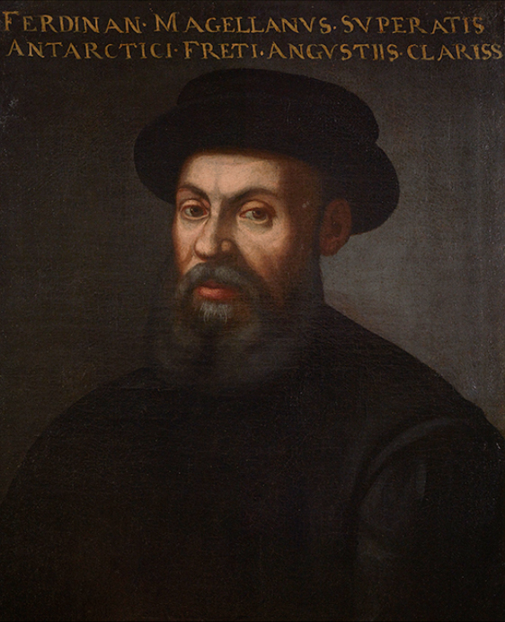
FERDINAND MAGELLAN

Slide 4
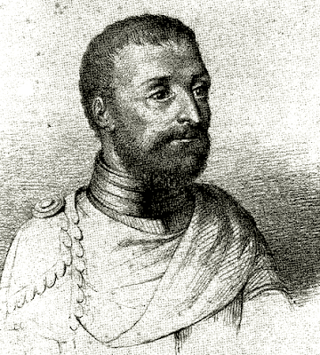
ANTONIO PIGAFETTA

Slide 5
THE FIRST VOYAGE AROUND THE WORLD BY MAGELLAN

Slide 6
MARCH 17 1521

Slide 7
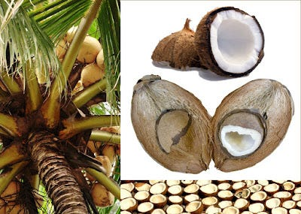
PIGAFETTA DESCRIBED WHAT SEEMED LIKE A COCONUT

Slide 8
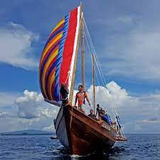
BALLANGAI (BALANGAY)

Slide 9
RAJAH CALAMBU

Slide 10
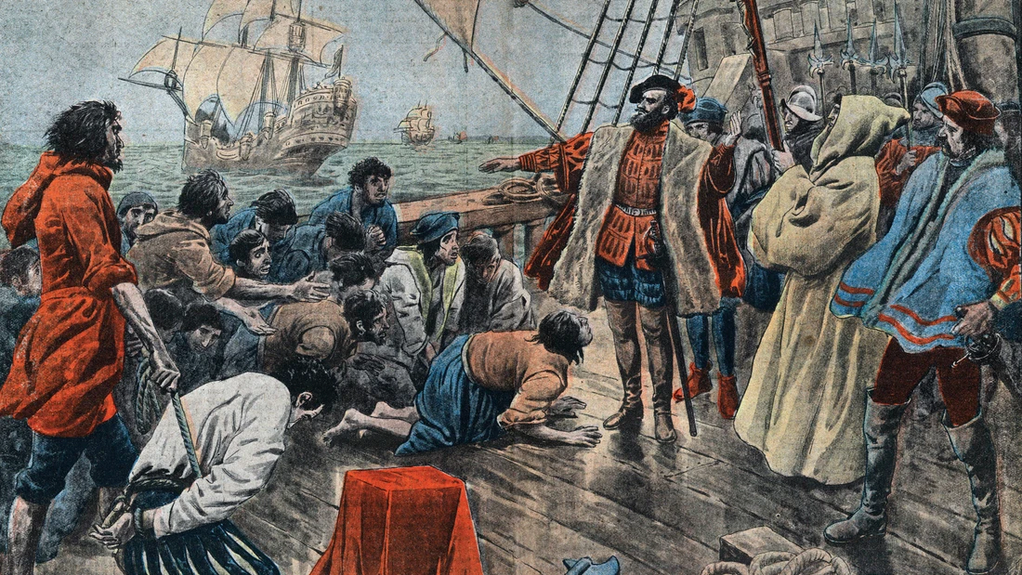
MARCH 31 (EASTER SUNDAY)

Slide 11
APRIL 7 MAGELLAN ARRIVED IN CEBU

Slide 12
APRIL 14 1521

Slide 13
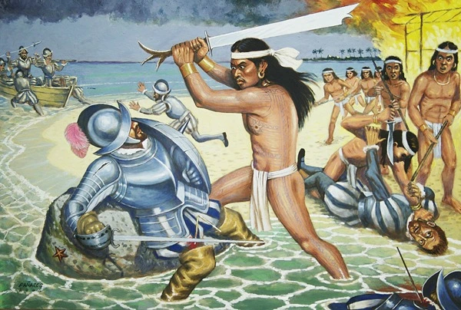
APRIL 27 1521

Slide 14
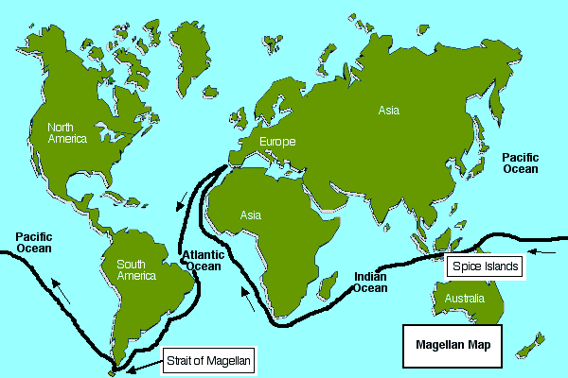

Slide 15
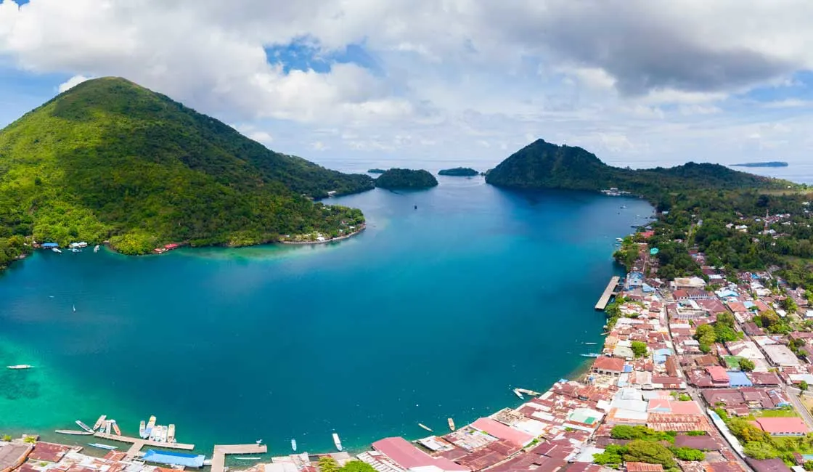
SPICE ISLAND

Slide 16
THANK YOU AND GODBLESS EVERYONE!

